Slide 1

Integrating Production Incident Alert through Geneos
Modern Infrastructure Systems Integration with Geneos

Slide 2
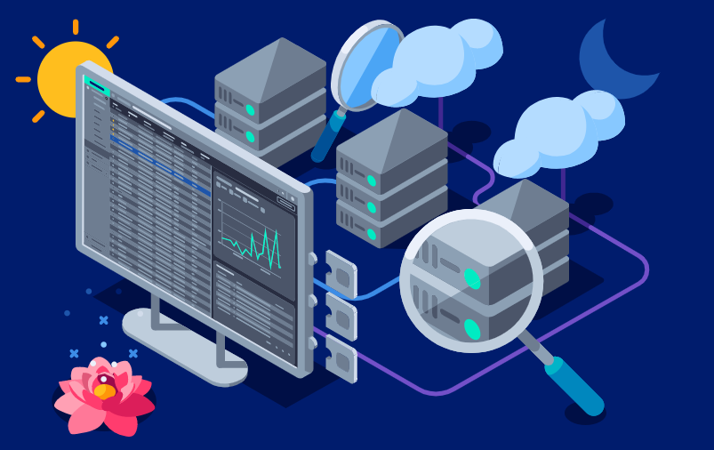
Need for Modern Intuitive Alerting for Production systems
In todays Modern Infrastructure Platforms , Production incident reporting should not just be part of the architecture but should be intuitive enough to understand the different types while the workload is at its peak
ITRS Geneos provides the realtime monitoring and alerting capabilities for a dynamic infrastructure which not only consists of cloud but on-prem systems

Slide 3
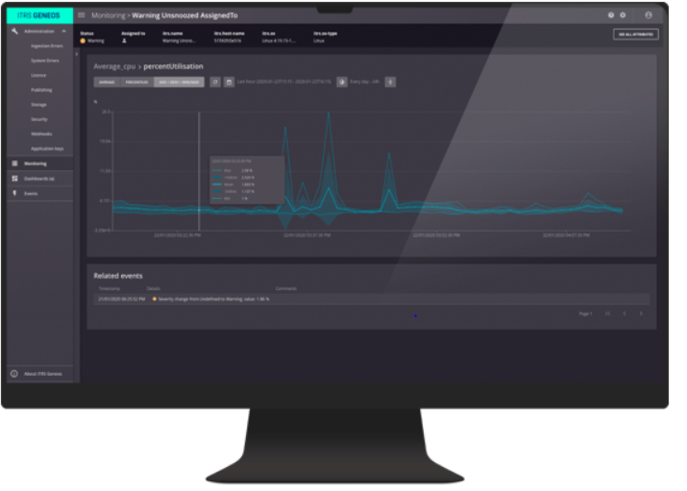
Steps to Integrate Geneos into Informatica eco-system
How it works:
1
Install Netprobe agent on your Platform servers or Containers
2
Identify the types of errors for which the error qualify for the Alerts and setup those alerts on the Geneos UI
3
Associate those alerts to the Production environment or servers where the agent is installed
4
You have now setup the alerts which can be viewed on the UI

Slide 4
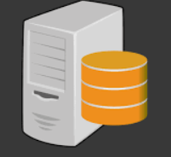
Design Diagram
NetProbes Agent
Keep looking for error Types in the logs
Geneos UI

Slide 5
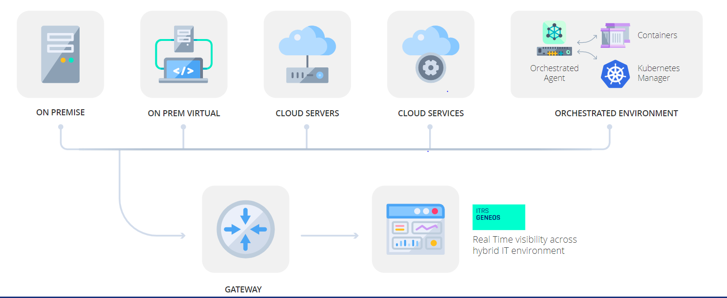
Key Benefits of Geneos Alerting system
1
The Alerting system is Proactive as they will be reported for the defined error types which will be constantly looked on by the Agent while the Production Load is running .
3
Alerts can be easily be configured and visualized on UI
2
Geneos can run on Cloud and on-prem systems thus ensuring no configuration overhead for modern Cloud Infrastructure than that setup on bare metal Infrastructure

Slide 6
Benefits or setting up Geneos (Contd)
4
Proactive Monitoring and Alerts, making a significant impact to application
2
Low Financial cost to Application Team
3
Improved Troubleshooting Root Cause Analysis by trending persistent data

Slide 7
Future enhancements
1
Geneos UI can setup Monitoring and dashboards which measure the potential skewness in data or quality
2
Can be integrated with microservice environment where alerts can be setup on the containers
3
Useful if you have a multi-cloud environment thus ensuring a single place to setup your alerts

